Slide 1
Fundamentals of
Hidden Markov Model (HMM)
(II) CHMM with applications to speech recognition
Ren-yuan Lyu
Dept of Computer Science & Information Engineering,
Chang Gung University,
Guei-shan, Taoyuan, Taiwan
rylyu@mail.cgu.edu.tw
Reference:
X. Huang, “Spoken Language Processing”, Chap 8
L. Rabiner, “Fundamentals of Speech Recognition”, Chap 6
HTK Book, http://htk.eng.cam.ac.uk/

Slide 2
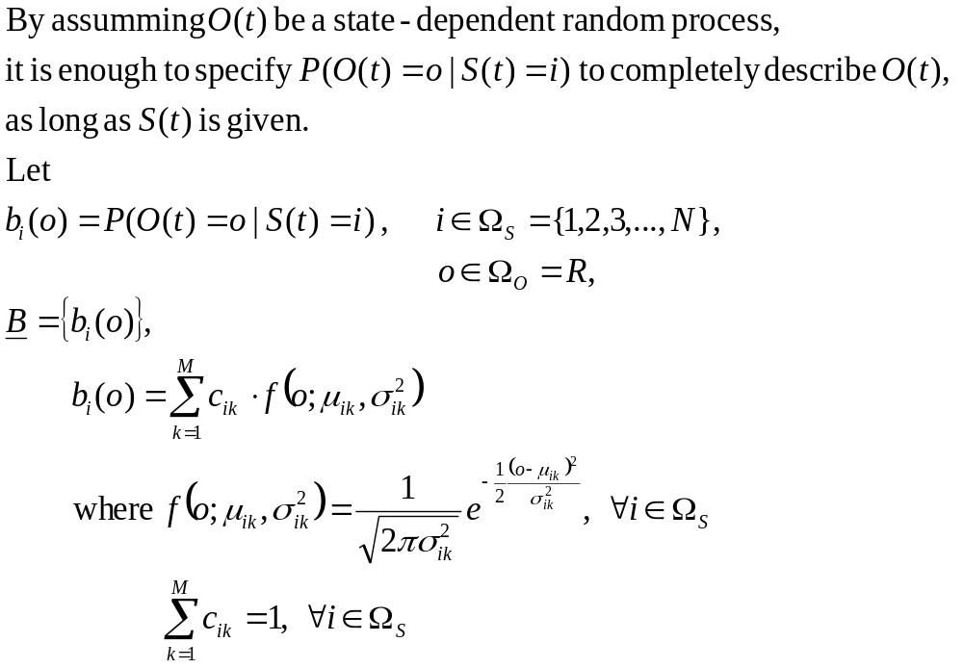
Continuous HMM (CHMM)
The (state-dependent) observation probability distribution, B= {b_{i}(o)}

Slide 3
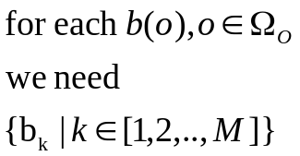
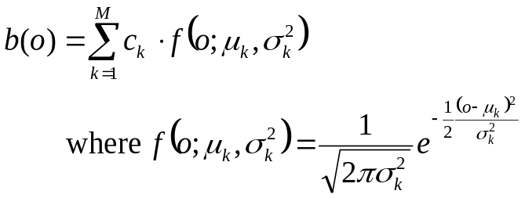
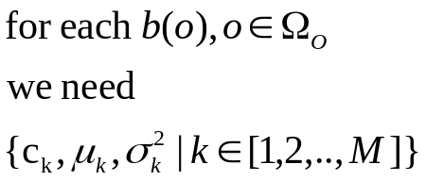
b(o)
o
1
M
b(o)
c_{M}
c₁
c_{k}
o
μ₁
….
μ_{k}
μ_{M}
….
σ_{M}
σ₁
σ_{k}

Slide 4
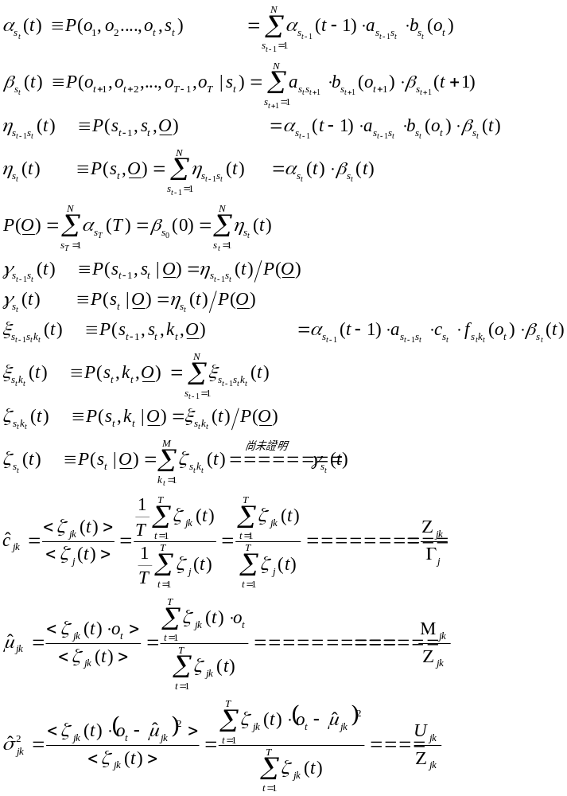
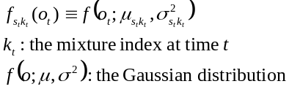
The training formula for
c, μ, σ

Slide 5
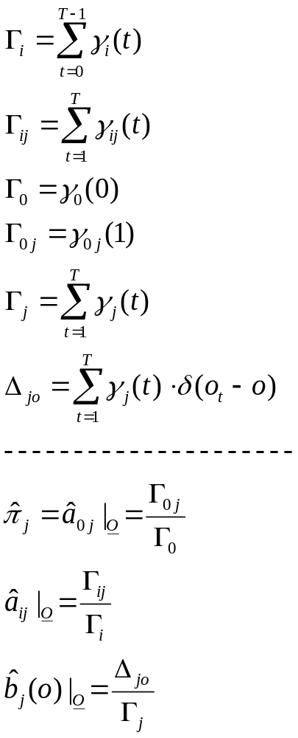
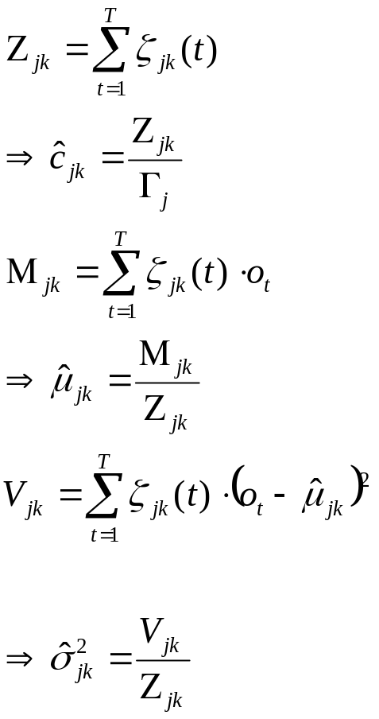
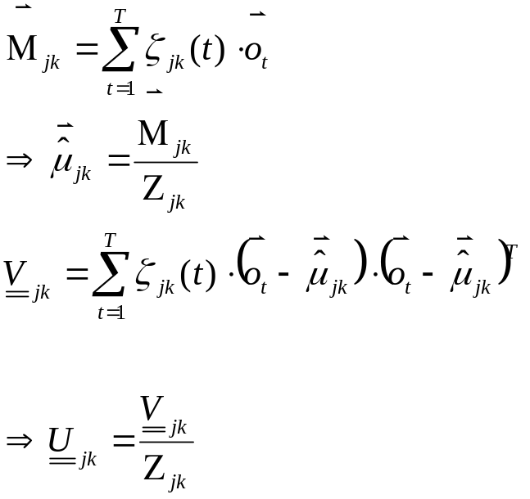
The training algorithm for c, μ, σ
For multi-dimensional
observation vector

Slide 6
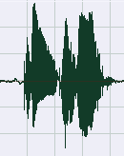

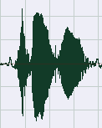
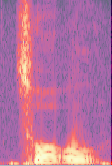
Isolated Word Recognition using CHMM
Data Preparation
DataBase
Recording
/Accessing
/Processing
Feature
Extraction
w₁=“正確”
w₂=“錯誤”

Slide 7
Training
HMM₁ for w₁
O for w₁
Training
π₁
1
a₁₁
a_{N1}
a_{1N}
o
Make P(O|π₁,A₁,B₁)
As large as possible
π_{N}
N
a_{NN}
o
HMM₂ for w₂
O for w₂
Training
π₁
1
a₁₁
a_{N1}
a_{1N}
o
Make P(O|π₂,A₂,B₂)
As large as possible
π_{N}
N
a_{NN}
o

Slide 8
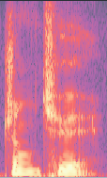
Recognition
HMM₁ for w₁
π₁
1
a₁₁
P(O|π₁,A₁,B₁)
a_{N1}
a_{1N}
o
O
π_{N}
N
a_{NN}
o
i*=Argmax P(O|π_{i},A_{i},B_{i})
W = w_{i*}
HMM₂ for w₂
i=1,2
π₁
1
a₁₁
P(O|π₂,A₂,B₂)
a_{N1}
a_{1N}
o
π_{N}
N
a_{NN}
o

Slide 9
Continuous Speech Recognition
..
..
o₁
o₂
o_{t}
o_{T}
begin
w₂
a₁₁
π₁
1
a_{1N}
a_{N1}
o
π_{N}
N
a_{NN}
o
w₁
a₁₁
π₁
1
a_{1N}
a_{N1}
o
π_{N}
N
a_{NN}
o
end
w₂
w₁

Slide 10
Large Vocabulary Speech Recognition
Sentence = “今天,天氣,不錯”
Sentence = W = W₁W₂….W_{(Nw)}
    “今天,天氣,不錯”= “今天”, ”天氣”, ”不錯”
Word, W=C= C₁C₂….C_{(Nc)}
    “今天”= “今”, ”天”
Character, C = S = S₁S₂….S_{(Ns)}
    “今” = “zin”
Syllable, S = P =P₁P₂….P_{(Np)}
    “zin” = “z”, “i”, “n”
Phone, P, has some variations
      mono-phone,
        “z”, “i’, “n”
      bi-phone,
        “z+i”, “i+n’, “n+sil”
      tri-phone,
        “sil-z+i”, “z-i+n’, “i-n+sil”
      Initial/Final
        “z”, “in”
        “z+i”, “in”
        “z+in”, “in”
要用1個HMM來代表何層次的語言單位？
N(Sentence) = ∞
N(Word) = 100K
N(Character) = 10K
N(Syllable) = 1K
N(Phone) =
N(Mono-phone) = .1K
N(bi-phone) = .5K
N(tri-phone) = 1 K
N(Initial/Final) = .5K

Slide 11
Continuous Syllable Recognition
“b”
“a”
:
“p”
“i”
“n”
:
“z”
“u”

